Slide 1
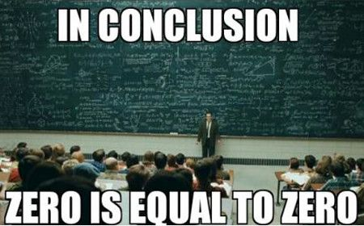


Metrics and Project Management
Session 9, Part 2
Steve Chenoweth, RHIT
Additional material here is from Stephen H. Kan, Metrics and Models in Software Quality Engineering, Ch 19
Notes:
Image from http://www.funniestmemes.com/funniest-memes-in-conclusion-zero-is-equal-to-zero/.
Kan’s book is ISBN 978-0-201-72915-3

Slide 2
This is applicable to both
Agile and Old School
Big views of metrics in both types of projects.
Kan’s conclusion is to do only the metrics you find most valuable.
He did a lot of research at IBM, to discover what those are.
The material here focuses on what metrics should be at the heart of delivering a timely, high quality software product.

Slide 3
What’s a metric?
It measures something, like:
  The software product
    Its quality
    Its degree of completeness, so far
    Its suitability for some use
  The process and people creating it
    How close to “on plan” are we?
    Tracking how the team is working
    Or what our test coverage is
    Or how we are cutting risks
It’s a number, a measure, vs some standard
  Like “burndown” or “velocity”
    See slide 9, in a bit →
Want to measure – “Is this product any good?”
Easier to measure things like “bug count.”
And, “Will it be ready on time?”

Slide 4
Recall Philips
The big Ch 6 reading on metrics…
What kind of metrics did he collect?
What purpose did these metrics serve?
Hint: If you don’t remember, realize this: Philips collects metrics for everything he wants to ensure is on-track, everything he wants to improve
  PSP is a perfect example

Slide 5
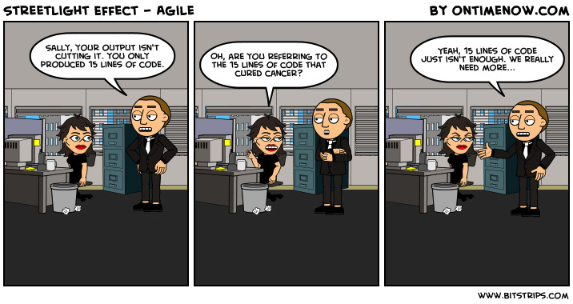
Issues with metrics…
Notes:
The streetlight effect: The streetlight effect is our human tendency to look for answers where it’s easy to look rather than where the actual information is. For instance, counting the lines of code produced is easy but doesn’t tell us anything about the quality of the application, the functionality it provides or even the effectiveness.

Slide 6
From the reading - SLIM
Measures these metrics:
Quantity of function (user stories)
Productivity (rate)
Time (project duration)
Effort (cost)
Reliability (defect rate)
  Which perhaps is best measured by good detection / testing associated with the project →
Notes:
APM, p 352

Slide 7
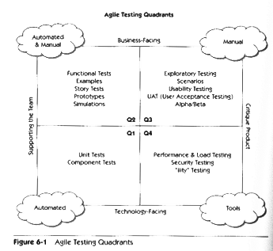
Remember these?
Notes:
Taken from Agile Testing: A Practical Guide for Testers and Agile Teams, by Lisa Crispin and Janet Gregory, 2009.

Slide 8
Outcomes vs Outputs
Outputs = productivity
Outcomes might also be, like:
  We did something entirely new
  We did it for a new customer
  We used new tools
And – “Did we do the best job delivering high-quality products in this situation?”

Slide 9
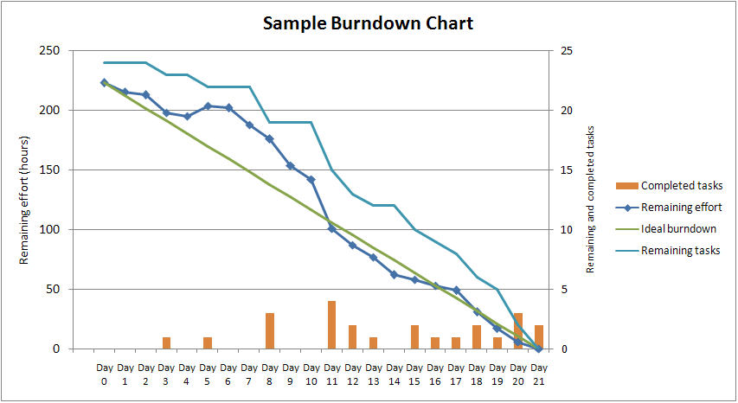
Agile likes burndown
(or burnup) charts
“Velocity” is dy/dx on the remaining tasks.
Notes:
From http://en.wikipedia.org/wiki/Burn_down_chart

Slide 10
What if you’re not going to make it?
In agile, do you…
Work faster?
Work longer hours?
Reduce what’s due this sprint?
Push out the sprint deadline?

Slide 11

Agile Metrics
Why is the burn down chart not enough?
Hint: let’s say your team was accurately using an agile process yet generally slacking off – how would you know that?
Hint: let’s say your team was accurately using an agile process yet overall not producing enough value to justify continuing the project – how would you know that?
What I burned down today:
Notes:
Reddit image from http://onlinelearningtips.com/2013/05/08/why-you-should-follow-raskhistorians-on-reddit/http://onlinelearningtips.com/wp-content/uploads/2013/05/reddit_history-300x300.jpg

Slide 12
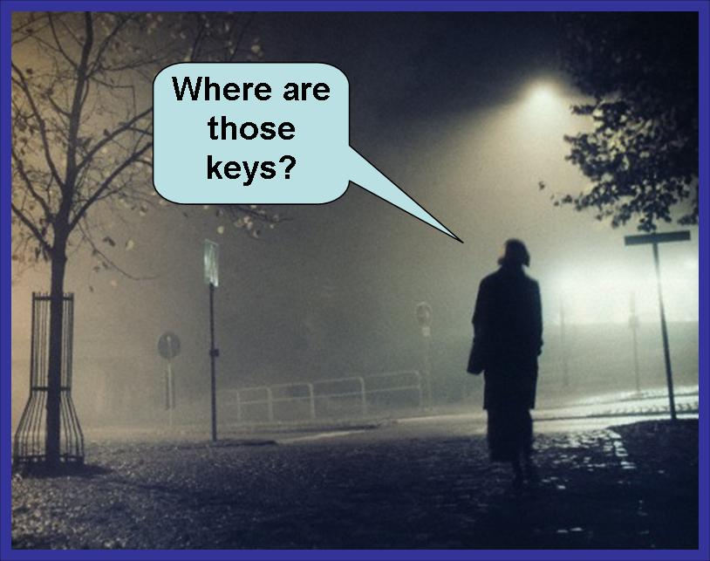
Measure value to the customer
First we must acknowledge that our performance measurement impacts agility
Second we must alter our obsession with time to an obsession for outcomes – that is customer value
Third we must separate the
outcome performance
measurement from the
output performance
measurement
  See next slide →
Notes:
Image from http://planninga-from-nanninga.blogspot.com/2010/08/strategic-planning-analogy-343-where-to.html

Slide 13
Outcomes vs. Outputs
Outcomes is a measure of the value produced for the customer
Output is various measures we can collect about our productivity
Output is only very approximately a proxy for outcomes
  Outcomes are delayed, for one thing
You actually want both (Highsmith)

Slide 14
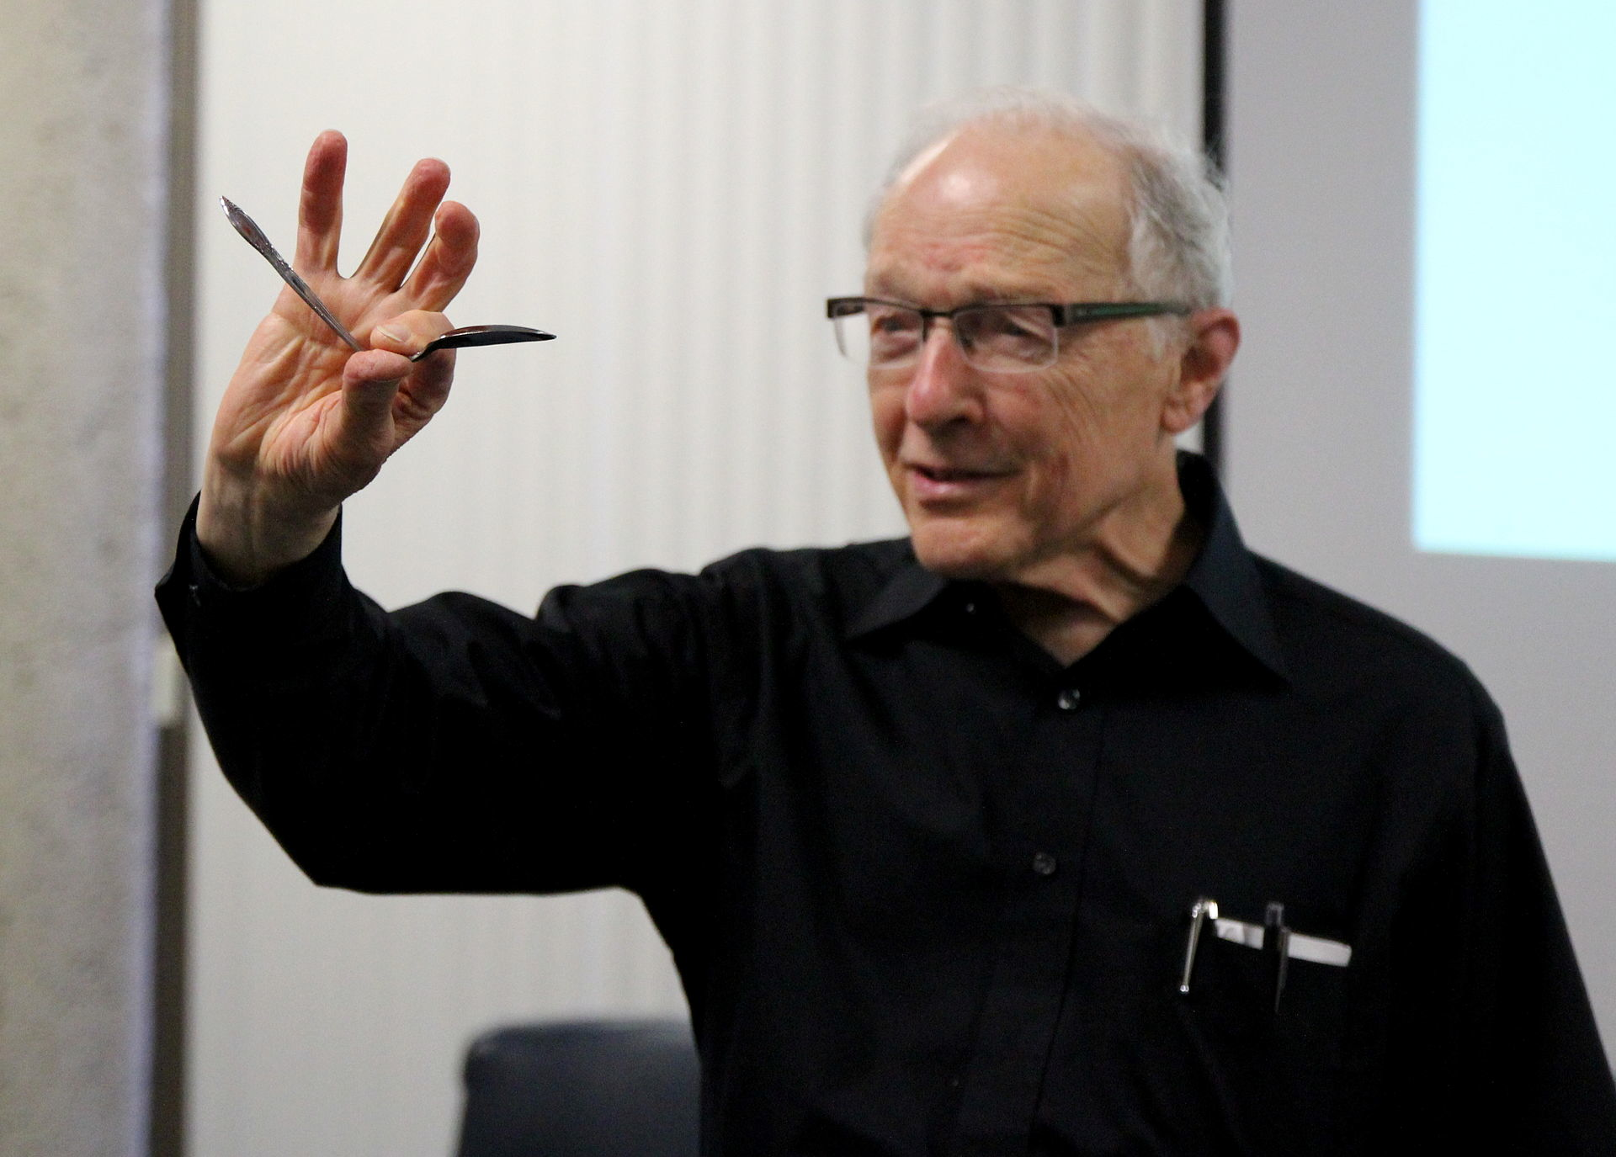
Problems?
On time
Under budget
Meets requirements
One company reported
it was on time, under budget, and met specifications 95% of the time
Above - Ray Hyman demonstrates Uri Geller's spoon bending feats at CFI lecture. June 17, 2012 Costa Mesa, CA
Notes:
Image from http://en.wiipedia.org/wiki/Spoon_bending

Slide 15
Beyond Burn Downs
Measuring value produced to the customer
Ensuring that your process is optimizing
Quantity of function
Productivity
Time
Effort
Reliability

Slide 16
Gaming the numbers
Highsmith says “trying to improve metrics” works for a while, and then starts failing
Numbers apply pressure – a low to moderate amount of pressure is good
Where I am
Process improvement
My Office
Distance
CANDY

Slide 17
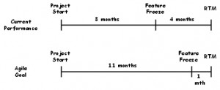
Shortening the Tail
A realistic goal to try for with Agile:
It cuts development time.
And it improves quality.
Notes:
Image from http://jimhighsmith.com/shortening-the-tail/, same as on p 356.

Slide 18
Is AgileEVM the answer?
In the article you read:
Goal is to forecast final project cost.
Points and burn-up predict end date.
But we can convert these to money.
Article shows how.
Does it work?

Slide 19
From Kan - Metrics and models are…
A step up from testing as QA
Opportunities to be systematic
Ways to use processes to improve quality
Also ways to speed up
delivery at the same time
Now – time for some
observations…

Slide 20
The right stuff!
This is what gives software engineering a scientific basis:
  What is measured can be improved.
Measurement must be integral to practice.
  Metrics and models become a way to study those measurements.
  Step 1 – the data must be good.
    So data collection must be systematic and enlightened.

Slide 21

Sources of bad data
Kan says the issue pervades the whole data processing industry.
Quality issues include also:
  Completeness
  Consistency
  Currency
Change is a culprit!
  Combining databases
  Organizations update
  Applications are replaced
Big data could be in for a
rude awakening.
Notes:
Kan p 470
Image from http://www.greenbookblog.org/2012/03/21/big-data-opportunity-or-threat-for-market-research/.

Slide 22
Ideal for software development
Automatic data collection as a side effect of development itself.
Not always possible – E.g.,
  Trouble tickets need to include an initial analysis.
  From customers, they require cleanup.
    “It’s doing funny again!”
  How do you trace defects back to their origin?
If it’s all automated, that’s harder to set up!

Slide 23
Kan’s data collection recommendations
Engineer the data collection process and entry process.
Human factors in data collection and manipulation for data quality.
  E.g., the process of handling change requests.
Joint information systems that maintain quality.
Data editing, error localization, and “imputation” techniques.
Sampling and inspection methods.
Data tracking – follow a random sample of records through the process to trace the root sources of error in the data collection and reporting itself.
Notes:
Kan p 471

Slide 24
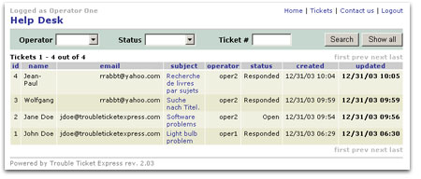
The flow of usage
Raw data
Information
Knowledge
Actions
Results
?
Notes:
Kan p 471
Image from http://www.troubleticketexpress.com/.

Slide 25
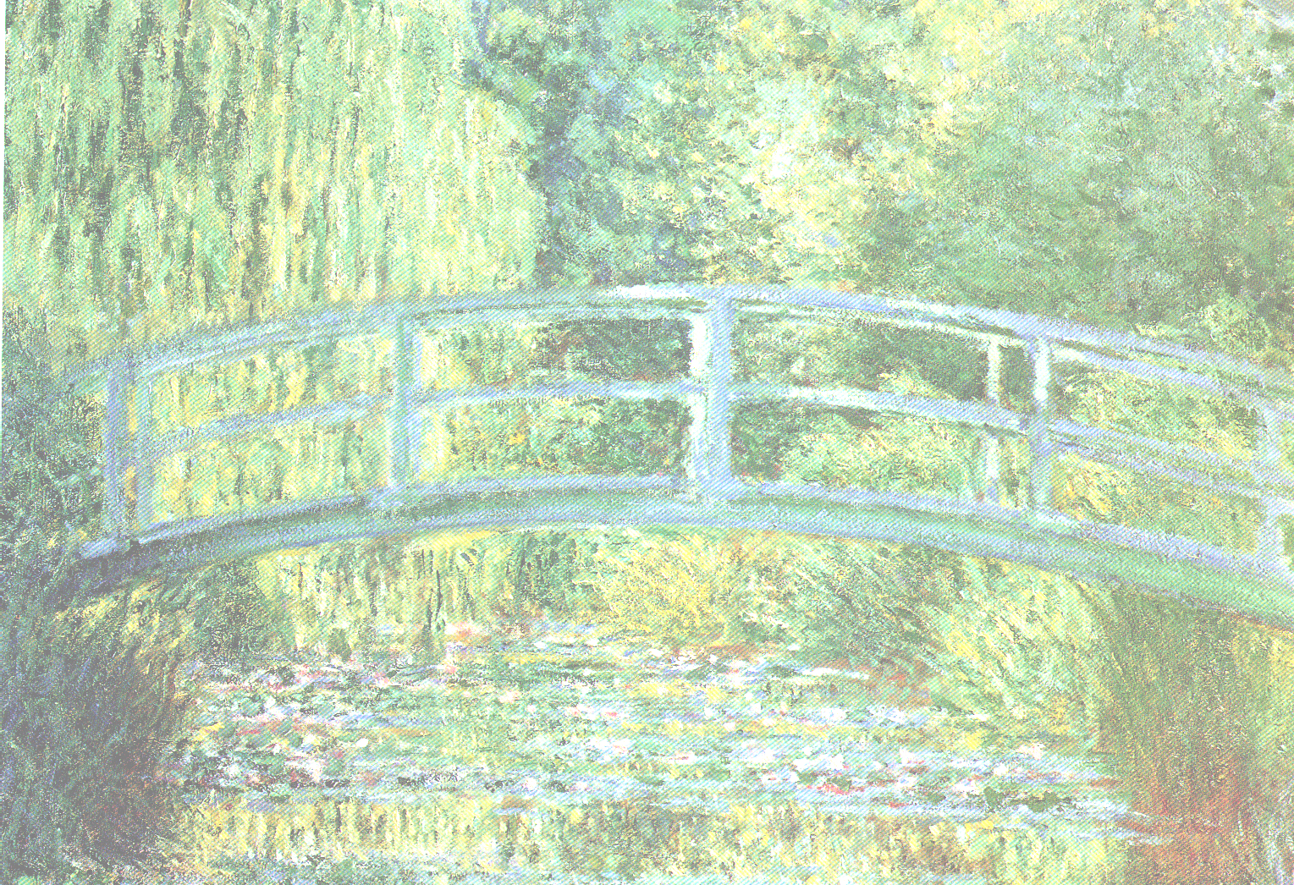
“…scientific knowledge does not by itself make a man a healer, a practitioner of medicine. The practice of medicine requires art in addition to science---art based on science, but going beyond science in formulating general rules for the guidance of practice in particular cases.” -- Mortimer Adler
Where is your organization on this progression?
"I am looking for something I have not done before, a shiver my painting has not yet given."
-- Claude Monet
Science
Production
Commercial
Craft
Professional
Engineering
E.g.,
“The focus of Cleanroom involves moving from traditional, craft-based software development practices to rigorous, engineering-based practices.” At http://www.sei.cmu.edu/ str/descriptions/ cleanroom_body.html
“What’s the
opposite of
Eureka?”
They think they’re here.
Is this the cause of the Agile vs Systems Engineering conflict?
We think we’re here.
Background is Claude Monet’s Le Bassin aux nymphéas, harmonie verte, 1899; Musée d'Orsay, Paris
Figure derived from Software Architecture: Perspectives on an Emerging Discipline, by Mary Shaw and David Garlan. Prentice Hall, 1996, ISBN 0-13-182957-2.
Notes:
In the Craft stage -- virtuosos, artists and
talented amateurs using intuition and brute force,
gaining haphazard progress through extravagant
use of available materials
In the Commercial stage -- skilled craftsmen use established procedures, training and pragmatic refinements to create a system for economic manufacture
In the Professional Engineering stage -- educated professionals use analysis and theory; progress relies on science
Shaw and Garland’s picture --
of the evolution of an emerging discipline
(like, oh, say, computer science !)
Fits in with SEI’s Capability Maturity Model (CMM), as well.
To many craft-stage artists, a project may not be interesting if it doesn’t include solving an almost impossible problem.
Painting is the central segment of The Water Lily Pond in Green, 1899, by Claude Monet (1840-1926). Paris, Musée d’Orsay / © Archiv für Kunst und Geschichte, Berlin.

Slide 26


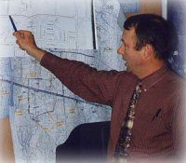
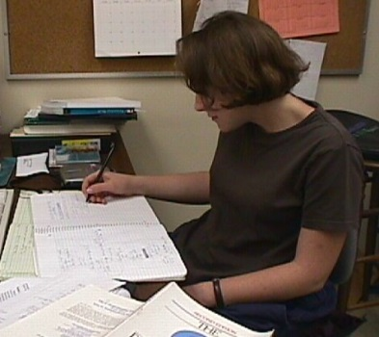
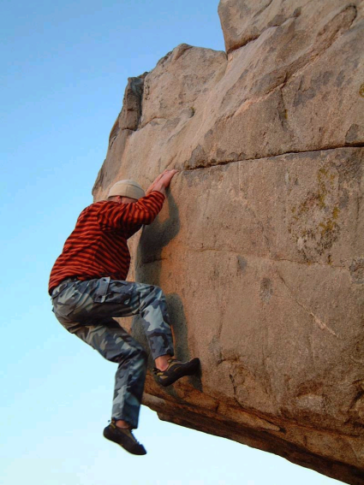
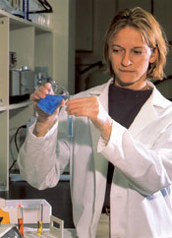
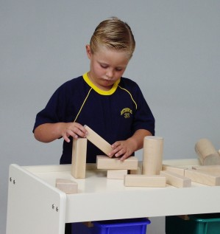
Top: The real person shown here is Denzil Biter, City Engineer for Clarksville, TN. See www.cityofclarksville.com/ cityengineer/.
“Here’s a great war story from the 1B project -- Impossible, but true!”
And where are your people on this one?
Cirque du Soleil aerial contortionist is Isabelle Chasse, from http://www.montrealenespanol.com/quidam.htm
Astronomer documenting observations. From www.astro.caltech.edu/ observatories/palomar/ faq/answers.htm.
Folklore
Ad hoc solutions
The “Novelty Circle” of engineering; or, “Hey, where’s my needle in this haystack?”
Codification
New problems
(novelty and nefarious outside forces)
Is Agile stuck forever back here?
Boulder climber from www.gtonline.net
/community/ gmc/boulder/pecqueries.htm
Models & theories
Image from www.
sturdykidstuff.com/ tables.html
“Yikes!”
Improved
practice
Background is Claude Monet’s Meule, Soleil Couchant, 1891; Museum of Fine Arts, Boston Figure derived from Software Architecture: Perspectives on an Emerging Discipline, by Mary Shaw and David Garlan. Prentice Hall, 1996, ISBN 0-13-182957-2.
Image from www.reg.ufl
.edu/ suppapp-splash.html.
Notes:
Because of the novelty
and increasing complexity
and new technologies in engineering problems,
This “progress” is really encountered as a loop
Technocracy is a reactionary’s best friend. But decades of failure have doomed the Cold War cult of the expert. There is no “one best way.”
-- Virginia Postrel, “Technocracy
R.I.P.,” in Wired, January, 1998.
Myth 1: It takes a great idea to start a great company.
Reality: Starting a company with a “great idea” might be a bad idea. Few of the visionary companies began life with a great idea. In fact, some began life without any specific idea and a few even began with outright failures. Furthermore, regardless of the founding concept, the visionary companies were significantly less likely to have early entrepreneurial success than the comparison companies in our study. Like the parable of the tortoise and the hare, visionary companies often get off to a slow start, but win the long race.
-- James C. Collins and Jerry I. Porras in Built to Last: Successful Habits of Visionary Companies. Harper Business, 1994, ISBN 0-88730-671-3, p. 7.
Painting is the central segment of Grain Stack, Sunset, 1891, by Claude Monet (1840-1926). Boston, Museum of Fine Arts, Juliana Cheney Edwards Collection.
What do innovators look like (in case you want to confirm that you are one, or even just spot one in a crowd of regulation-minded telecom engineers)? Watch out! Here’s what the official answer in the encyclopedia says:
Many creative people show a strong interest in apparent disorder, contradiction, and imbalance; they often seem to consider asymmetry and disorder a challenge. At times creative persons give an impression of psychological imbalance, but immature personality traits may be an extension of a generalized receptivity to a wider-than-normal range of experience and behaviour patterns. Such individuals may possess an exceptionally deep, broad, and flexible awareness of themselves.
Studies indicate that the creative person is nonetheless an intellectual leader with a great sensitivity to problems. She exhibits a high degree of self-assurance and autonomy. She is dominant and is relatively free of internal restraints and inhibitions. She has a considerable range of intellectual interests and shows a strong preference for complexity and challenge.
The unconventionality of thought that is sometimes found in creative persons may be in part a resistance to acculturation, which is seen as demanding surrender of one's personal, unique, fundamental nature. This may result in a rejection of conventional morality, though certainly not in any abatement of the moral attitude.
-- from the Encyclopaedia Britannica [Note: The “She’s” originally were “He’s,” in paragraph 3, above. Does it matter?]
¹Answer: somewhere in the haystack in the background. (It’s an Ameri-can saying that a tough problem is like “finding a needle in a haystack.”)

Slide 27
Next problem - analysis
Tendency to overcollect and underanalyze
Should have an idea what’s useful – first
  “Analysis driven”
  Know the models you are going for
To some extent, metrics and measurements progress with the organization.
  If your org is back in the initial stage, a lot of metrics may be counterproductive.
    E.g., no formal integration and control – how do you track integration defects?

Slide 28
Analysis – where to start?
Metrics centered around product delivery phase
Then work backward into development process:
  Gives in-process metrics.
  See next slide →
And work forward to track quality in the field.
  These are easier to setup.
  A part of support, already.
Notes:
Kan pp 472-3

Slide 29
“In-process” metrics to start with
A
Product defect rate (per specified time frame).
Test defect rate.
What is desirable goal for A?
  Monitor by product.
Ditto for B.
How do A and B correlate, once several data points are available?
If they do, use that relationship to measure testing effectiveness. And,
B/A metric becomes a target for new projects.
Monitor for all projects.
B
Notes:
Kan p 473

Slide 30
Then it gets messier
How to improve the B/A value?
  Is test coverage improving?
  How to improve the test suite?
Easier to do all this at the back end than at the front end.
Notes:
Kan p 473

Slide 31
Rec’s for small teams
Start at the project level, not at the process level or organizational level.
  Pick projects to start with.
Integrate the use of metrics as a part of project quality management.
  Which is a part of project management.
  The project lead can do the metrics, with support from everyone else on the project.
Select a very small number of metrics (2-3).
Always make it visual.
Notes:
Kan p 474

Slide 32
Keys for any org
Secure management commitment.
Establish a data tracking system.
  Process and tools
Establish relevance of some specific metrics.
Also need to invest in metrics expertise.
  For a large org, full-time professionals.
    E.g., training in statistics.
Developers play a key role in providing data.
End up with software data collection as a part of project management and configuration management.
Go for automated tools.

Slide 33
Modeling
Software quality engineering modeling – a new field:
  Reliability and projection models
  Quality management models
  Complexity metrics and models
  Customer-oriented metrics, measurement and models.

Slide 34
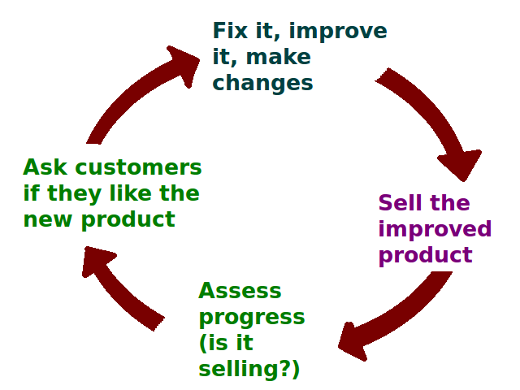
End result – customer sat
Lots of literature on this topic.
Beyond just software engineering.
“Finishing school” on this topic would be a marketing course.
Notes:
Image from http://en.wikipedia.org/wiki/Customer_satisfaction.

Slide 35
Technical problems
The reliability / project, quality, and complexity models are developed and studied by different groups of professionals!
  Training in different areas.
  The first tend to be black box models.
Urgent problem – bridge the gap between art and practice.
  Needs to be in CS curriculum to learn these topics.

Slide 36
Technical problems - cntd
Different reliability models for different kinds of systems.
  E.g., for safety critical, it’s time to next failure.
Need systems of sufficient size to count and predict reliability:
  May not have enough data to predict.
  It’s workload dependent.
  Test cases may not be accurate.

Slide 37
And software issues!
Software is unique:
  The debugging process is never replicated.
  Thus, software reliability models are “largely unsuccessful.”
  Try “fuzzy set methodologies,” neural nets, or Bayesian models to argue about them.
Always establish empirical validity for the models you choose to use.
  The model’s predictions are supported by real results.
Notes:
Kan pp 478-9

Slide 38
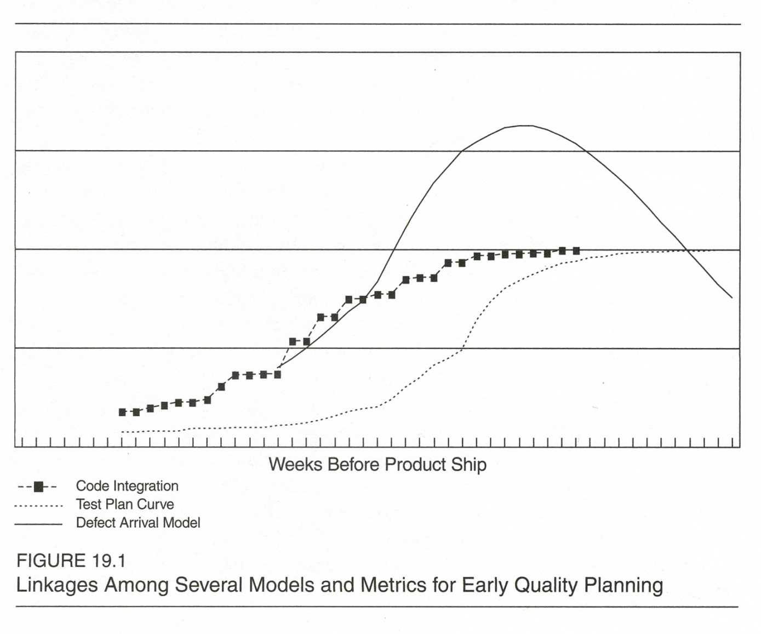
Linkages among models
Notes:
Kan p 480

Slide 39
Statistical process control
Control charts probably won’t work (Ref Kan, Ch 5).
Among other things, when the good data is available – the software is complete!
A possible tool for consistency and stability in process implementation.
Software development is far more complex and dynamic than the scenarios control charts describe.

Slide 40
Statistical hypothesis tests
Kan recommends the Kolmogorov-Smirnov test.
The 95% confidence intervals are often too wide to be useful.
Using the 5% probability as the basis for significance tests, they seldom found statistical differences.
Notes:
The Kolmogorov-Smirnov test (KS-test) tries to determine if two datasets differ significantly. See http://www.physics.csbsju.edu/stats/KS-test.html
Kan p 482

Slide 41
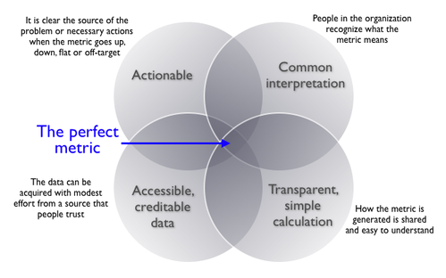
Ta-da!
I give you…
Notes:
From http://www.juiceanalytics.com/writing/choosing-right-metric.

